Slide 1












LWB based on LionWeb
bulk protocol
Derived
interpretations
«StringValue»
CallFromX
“Hello”
«StringValue»
CallFromY
“Bye”
delta protocol
«Concept»
Node
Interpreter
Derived
scopes
«LocalScope»
→ funcA
«GlobalScope»
→ main
Scoping
engine
Derived
types
«PrimitiveType»
String
Typesystem implementation
Derived
validations
«Finding»
Warning
“Name should start lower-case”
Validator
Original
model
Docs generator
«Function»
MyFunc
«Overrides»
→ otherFunc
Diagram
editor
Projectional editor
Importer
Live preview
Migration

Slide 2
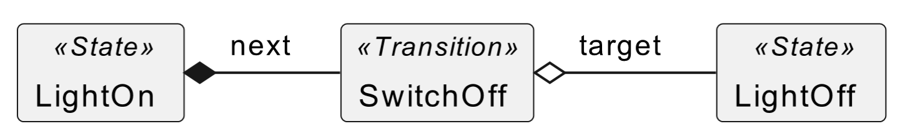
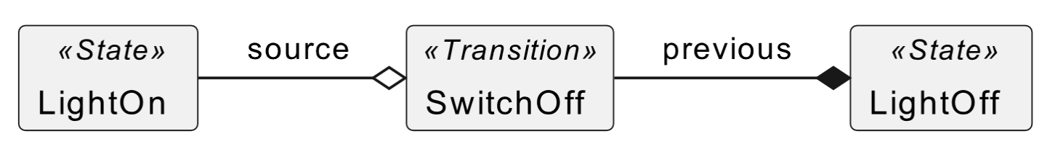
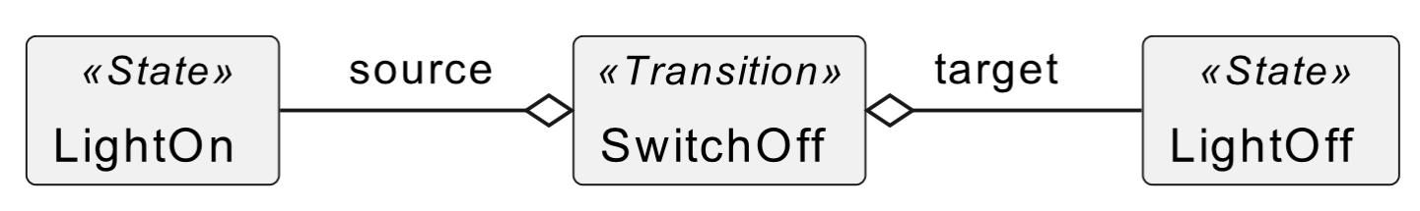

Slide 3

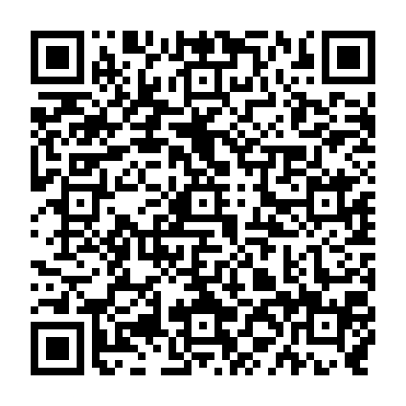
Team and Contact
Meinte Boersma DSL Consultancy
Erkan Diken F1RE
Norman Koester itemis (Modelix)
Sergej Koscejev Freelancer
Sascha Lisson itemis (Modelix)
Pedro Molina Metadev
Eugen Schindler Canon Production Printing
Team
Alex Shatalin JetBrains (MPS)
Niko Stotz F1RE
Federico Tomassetti Strumenta
Markus Voelter Freelancer
Ulyana Tikhonova F1RE
Jos Warmer Freelancer (Freon)
Want to work with us: GitHub: Web:
info@lionweb.io https://github.com/LionWeb-io https://lionweb.io/
Slack to follow us, use, or implement LionWeb:
https://join.slack.com/t/lionweb/shared_invite/zt-2k1k5bsv7-EvC2IABIgSxWrqJNVOZ0HQ
Contact

